Slide 1
User Centered/Experience Design and Research
Dawn Shaikh
adshaikh@gmail.com (LinkedIn)

Slide 2
What will we cover today?
What is User Experience/User Centered Design
Basics from Don Norman
How does UX fit into the development cycle
Notes:
Cover the agenda

Slide 3
Let’s consider some experiences

Slide 4
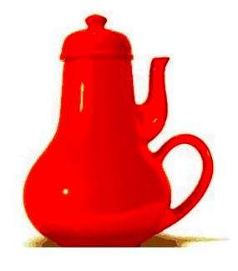
Could you use this teapot?
Notes:
Let’s look at a few examples of physical products and think through their usability in every day life. These are from the works of Donald Norman and his book The Design of Everyday Things..
This book is often one of the first books user experience folks read back in the day that got them excited about solving user interaction problems

Slide 5
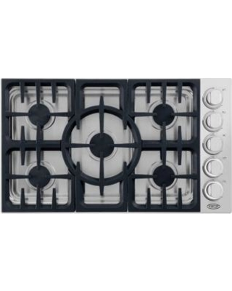
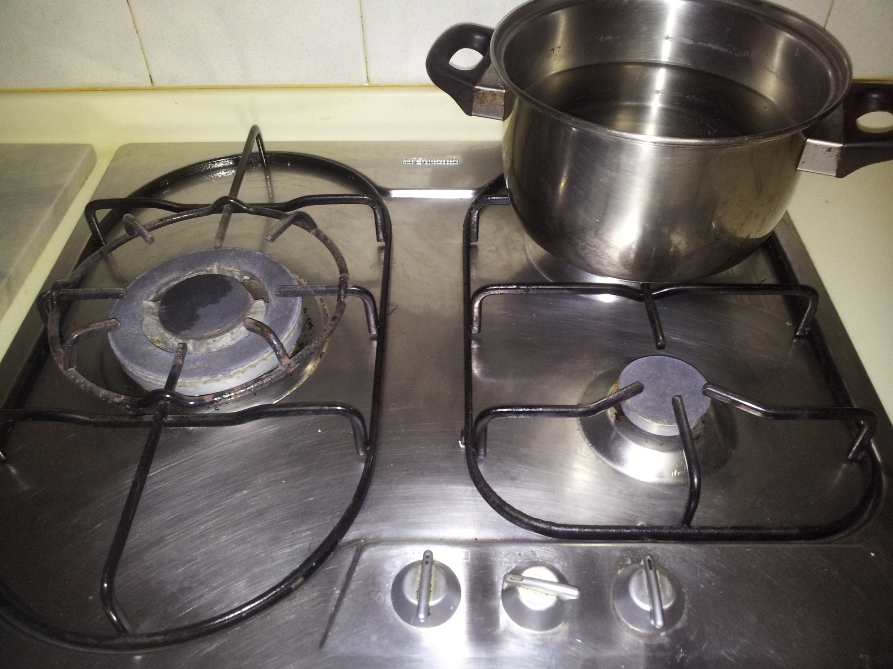
Which dial controls which burner?
photo credit: photo 1; photo 2
Notes:
UX professionals try to avoid design decisions that leave users confused…
Consider everyday things like burner dials on stoves.Why do force users to think and physically map the dials to burners?
Think about things like airport bathrooms - why do doors push in when we often have suitcases to maneuver into the stall?

Slide 6

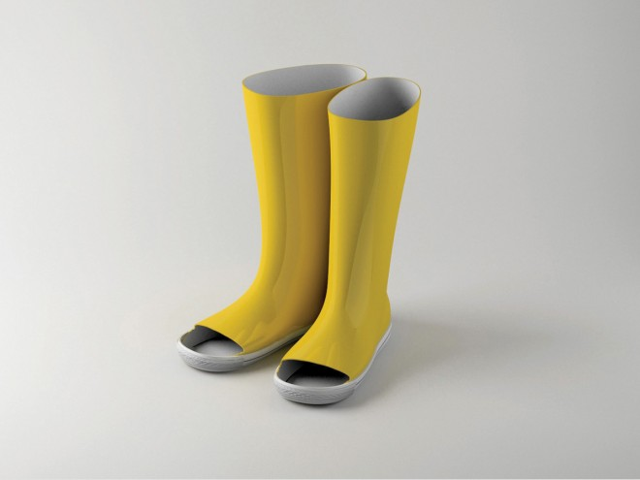
Usable based on purposes/uses?
photo credit: photo 1; photo 2
Notes:
Designers like to build beautiful things.. Like these beautiful salt/pepper shakers, but how usable and useful are they?
Creators like to be innovative - Rain boots with toe cut outs?

Slide 7
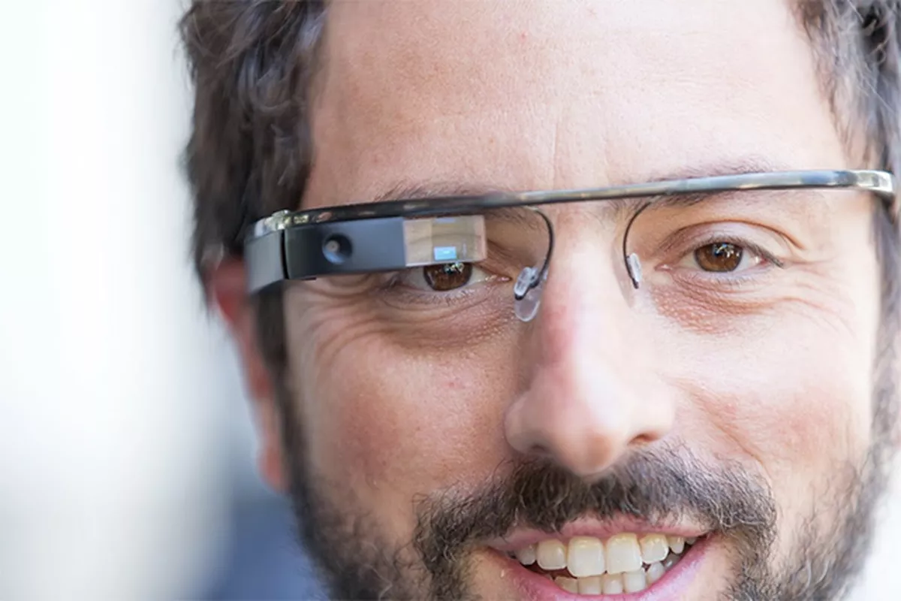
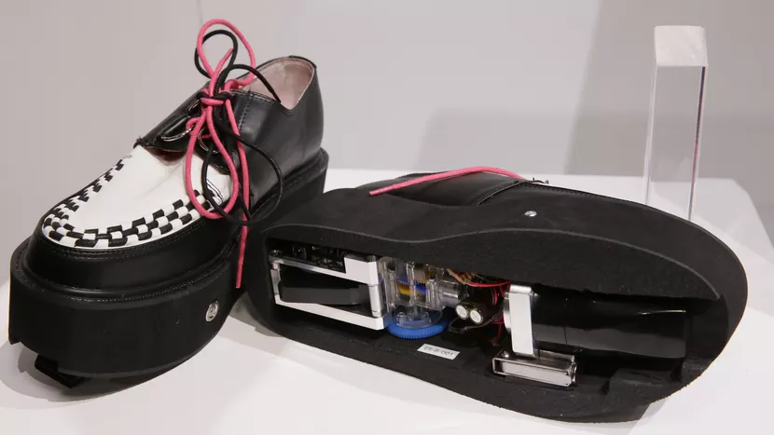
What do you use these for?
photo credit: photo 1; photo 2
Notes:
Software engineers like to build products that utilize cutting edge technology… sometimes the technology is not aligned with user needs or goals.
Google Glass and Vacuum Cleaner Shoes (2017)

Slide 8
Do you have examples of products that don’t quite meet your needs?

Slide 9
What is user experience or user-centered design

Slide 10
Human Centered Design
User Centered Design
User Experience
Notes:
How are these terms the same? Different?
Let’s go through what each of these mean and then settle on one term for the rest of this talk.

Slide 11
Human Centered Design
According to IDEO, Human Centered is a belief that all problems, even ones as complex as poverty and clean water, are solvable.
HCD is deeply rooted in the notion that the people who face the problems every day are the key to solving the problems.
HCD focuses on working with communities to test and build products that meet their needs.

Slide 12
User Centered Design/User Experience
User Centered Design can be considered a subset of Human Centered Design.
Instead of focusing on all humans, UCD focuses on the target users for a given product or experience -- UCD is an approach to design that grounds the process in information about the people who use the product.
UCD is a process that leads to the User Experience.
Notes:
I am most comfortable using the team User Experience, for the entire process. So that is what I wil do.

Slide 13
User Centered Design/User Experience
The goal of UCD is to offer products and experience that will support users’ beliefs, values, attitudes, and habits.
In order to do this, UCD is deeply rooted in understanding users and their interactions with existing and proposed solutions.
No guesses, no opinions.
UCD is the combination of design thinking and research.
Notes:
I am most comfortable using the team User Experience, for the entire process. So that is what I wil do.

Slide 14
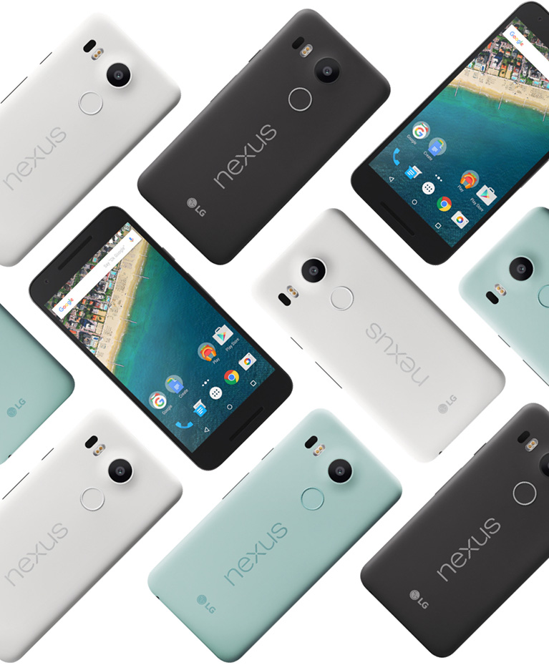
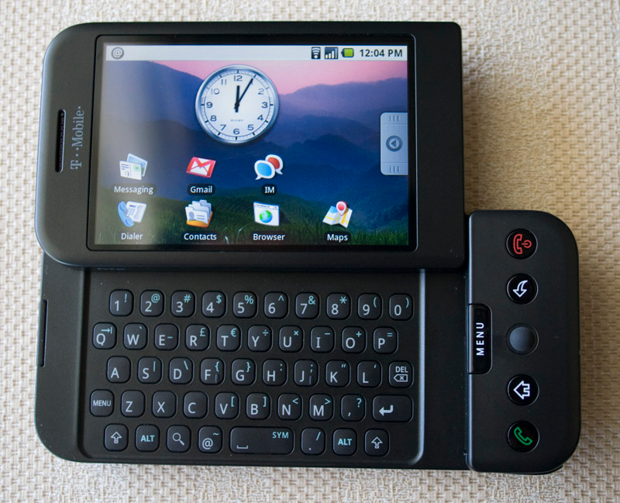
User Experiences are dynamic and change over time
Notes:
Today most of our products are mobile first. But the user experience of mobile devices have changed a lot since I got my first G1 in 2007.

Slide 15
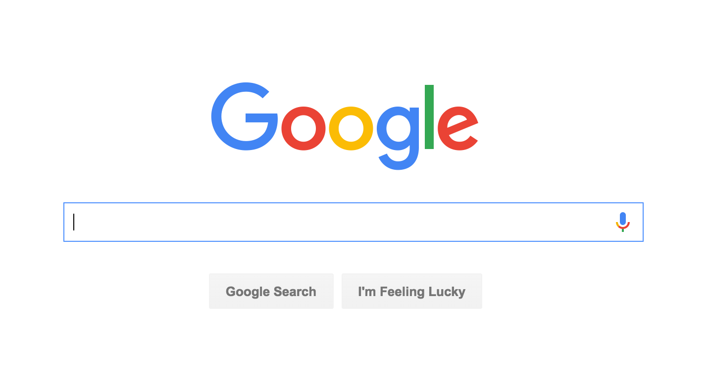
User experience online
Notes:
User Experience online is a lot like user experience of things like stoves and salt/pepper shakers
Websites and apps must be useful, usable, and delightful.

Slide 16
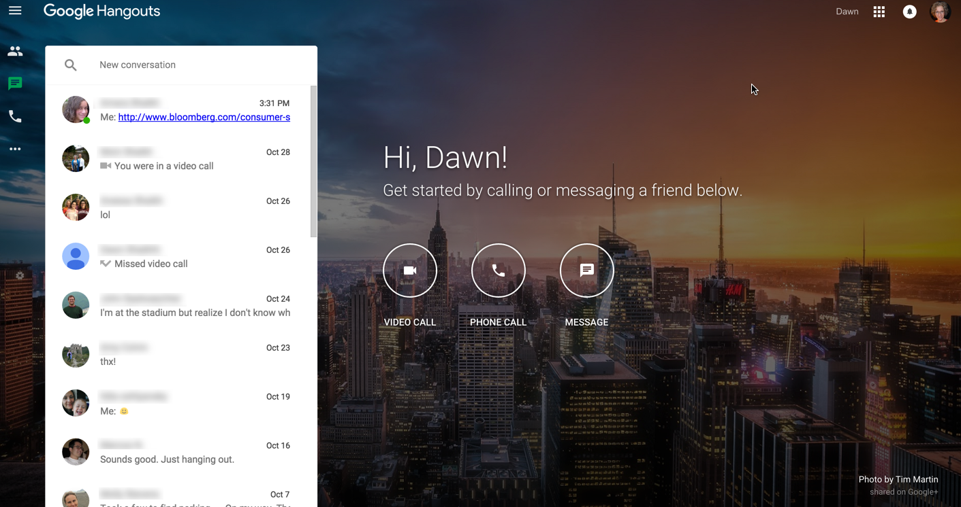
User experience online
Notes:
This is true for consumer products, like Google Hangouts

Slide 17
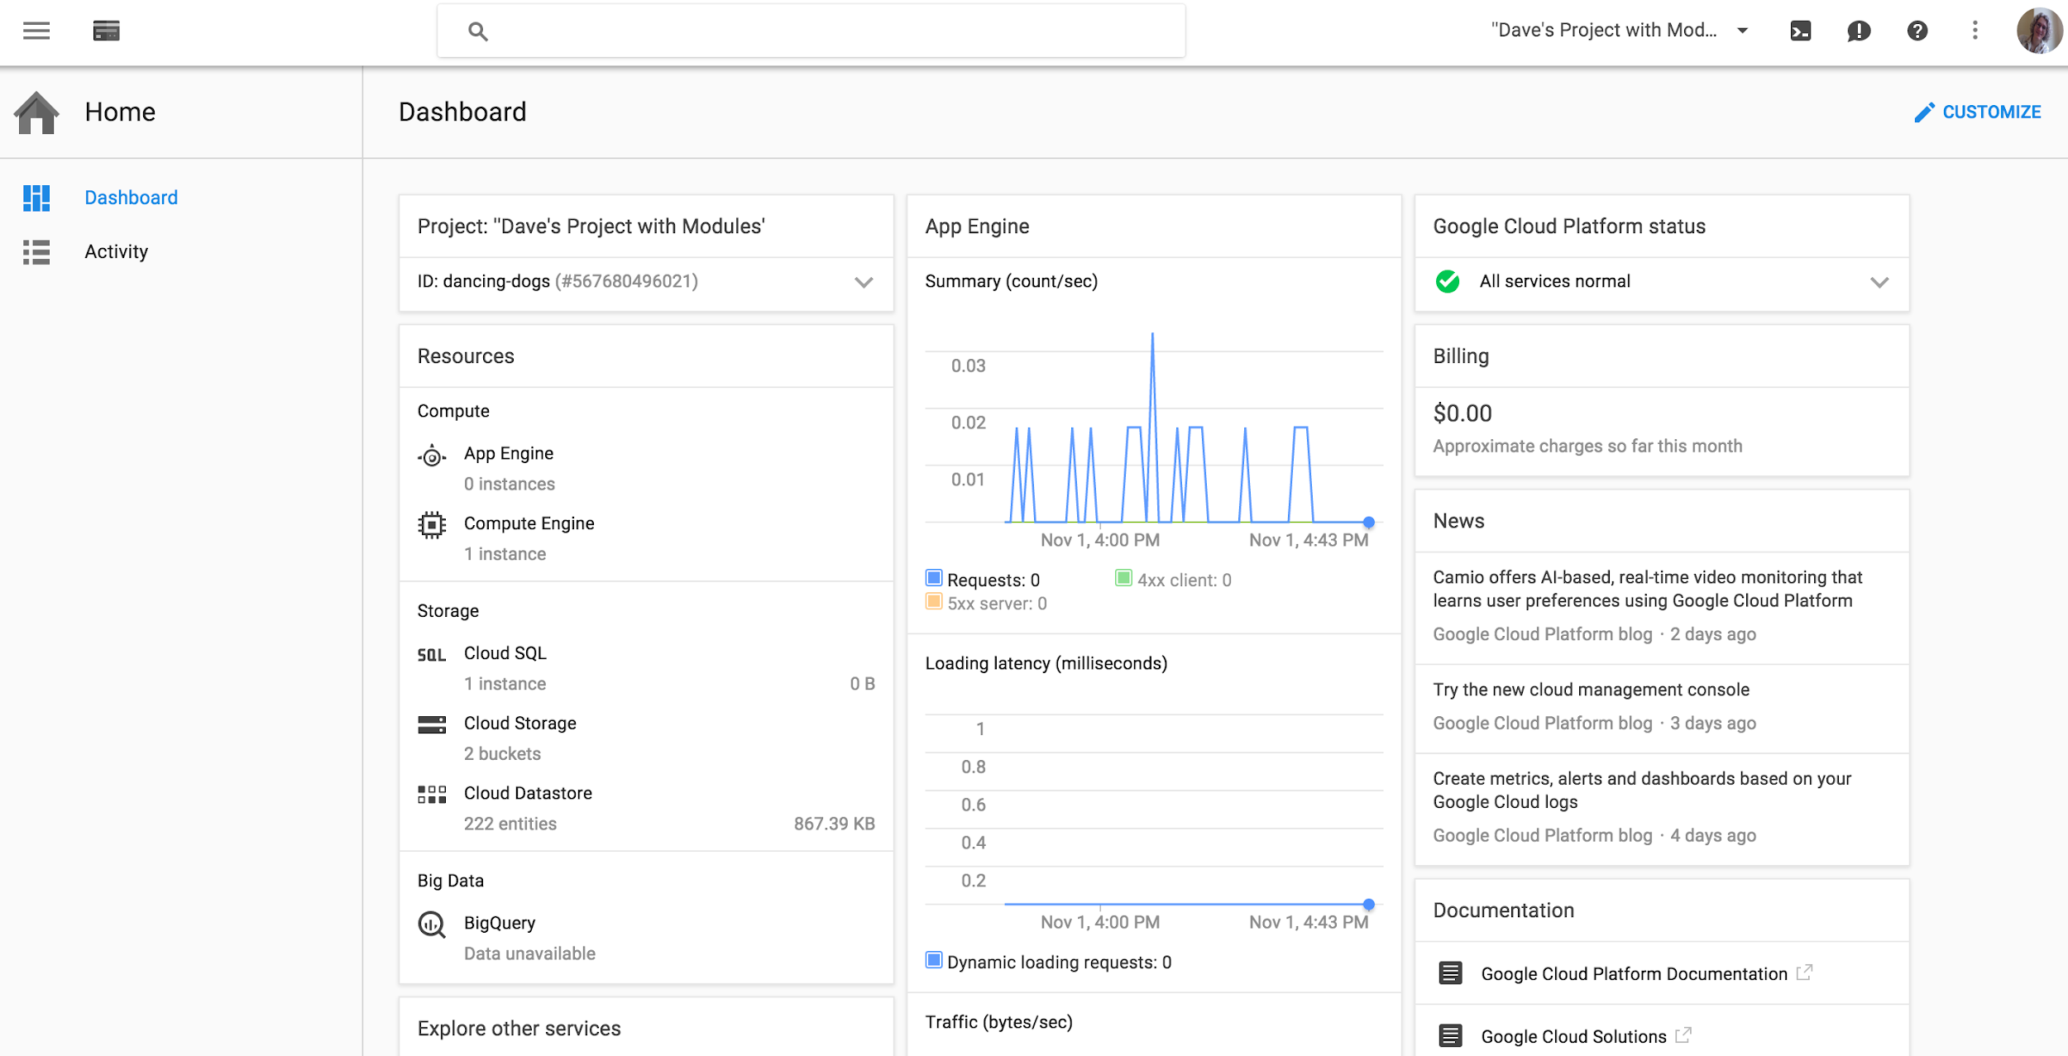
User experience online
Notes:
And enterprise-level products like Google Cloud Platform - Google’s tools for external developers who are developing in Google’s Cloud.

Slide 18

UCD process answers these 4 core questions
WHO are you designing for?
What are the users’ NEEDS?
What are the TASKS users need to perform?
In what ENVIRONMENT will the product/feature be used?
Notes:
This is the key message to drive home… these are not easy to answer and require a lot of effort.
Consider designing a writing system for this environment v. a classroom.

Slide 19
Some basics from Norman
Notes:
Norman offered us a set of UCD principles. This is one set of principles that is highly recognized and respected. The other readings I assigned offer variations on principles. Go with what works for you.

Slide 20
Products and features that are designed well meet users needs while being discoverable and understandable.
Notes:
How are these terms the same? Different?
Let’s go through what each of these mean and then settle on one term for the rest of this talk.

Slide 21
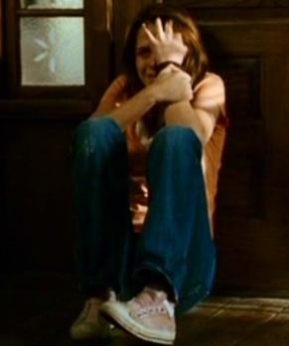
Focusing on the users
Discoverable? Is it possible to figure out what actions are possible and where and how to perform them?
Understandable? What does it all mean? How is it supposed to be used?
Focus on the actual target users -- engineers often think logically and this is not true for all users
Notes:
Photo cred
Story of google web fonts -- Jeremy rocking in the corner

Slide 22
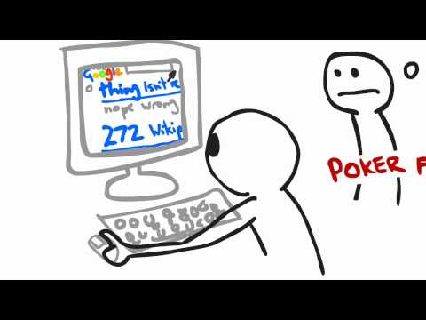
Notes:
Why is it important to focus on actual users?
Several years ago, a VP decided that everyone was going to interact with real users through user research because the session he observed with a team felt like this…

Slide 23
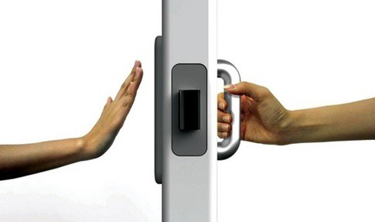
6 principles of UCD ala Norman
Affordances
Signifiers
Constraints
Mappings
Feedback
Conceptual Model
Notes:
Photo cred
Story of google web fonts -- Jeremy rocking in the corner

Slide 24
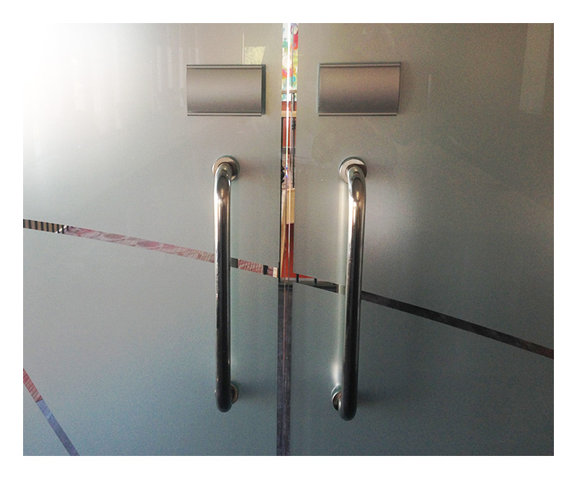

6 principles of UCD
Affordances
Signifiers
Affordances are the relationship between the physical object and the user. They are based on the abilities of the user. Users know they can do something.
Signifiers enhance the affordance of something - a mark or sound to indicate the appropriate behavior or a perceived affordance. Users know what to do.
Notes:
Examples of affordances v. signifiers?
Photo cred top
bottom
Affordances
Relationship between the physical object and a person
What is the item for? It must be obvious what a control or object is for.
Based on abilities of the user
Glass affords seeing through but not passage of physical objects
Do examples here
Signifiers
Afffordances communicate what actions are possible. Signifiers communicate where the action should take place. They are any mark or sound that communicates appropriate behavior. We need both.
Allows designers and engineers to communicate the purpose, structure, and operation of the device to users.
In some cases, signifiers are perceived affordances
Examples - push on a door
Affordances are the possible interactions between people and the environment. Some affordances are perceivable, others are not.
Perceived affordances often act as signifiers, but they can be ambiguous.
Signifiers signal things, in particular what actions are possible and how they should be done. Signifiers must be perceivable, else they fail to function

Slide 25

6 principles of UCD
Affordances
Signifiers
Constraints
Constraints guide actions or eases interpretations. For example, you cannot move the cursor beyond the screen. Or you cannot type outside the “slide” when creating presentations.
Notes:
The door frame is a constraint -- the door cannot go past that part of the frame which forces it to go in one direction only
Providing physical, logical, semantic, and cultural constraints guides actions and eases interpretation.
4 types: physical, cultural, semantic, and logical
Photo cred
https://cdn-images-1.medium.com/max/800/1*otgVFtWtj8YijOPGMPRjOA.png

Slide 26
6 principles of UCD
Affordances
Signifiers
Constraints
Mappings
Mapping is the relationship between control and effect. A good example is the vertical scroll bar - it roughly shows the place in the document.
Notes:
Mappings
The relationship between a control and its results is easiest to learn wherever there is an understandable mapping between the controls, the actions, and the intended result.

Slide 27
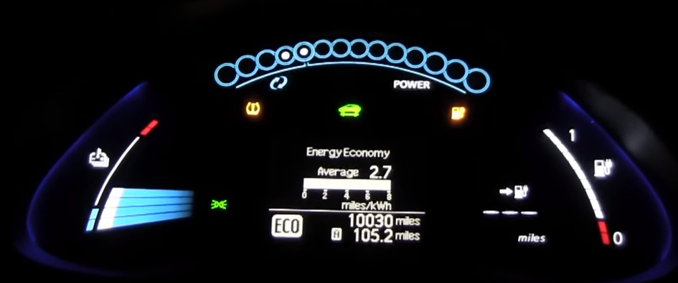
6 principles of UCD
Affordances
Signifiers
Constraints
Mappings
Feedback
Feedback communicates the results of an action. It must be immediate. Feedback should always be intentional and thoughtfully planned.
Notes:
Photo cred YT link
Feedback
Communicating the results of an action
Good example with Campaign Optimizer
Must be immediate
Feedback must be planned and intentional and part of the design system

Slide 28
6 principles of UCD
Affordances
Signifiers
Constraints
Mappings
Feedback
Conceptual Model
A Conceptual Model is a personalized, explanation that is highly simplified of how something works that can be used to predict behavior for future events and uses. It is often inferred and not highly accurate.
Notes:
Conceptual Model
an explanation, usually highly simplified, of how something works; valuable in providing understanding, in predicting how things will behave, and in figuring out what to do when things do not go as planned
Often inferred
Often personalized
The above principles greatly influence the conceptual model

Slide 29
These principles enable you to fully answer the 4 core questions… who | needs | tasks | environment.

Slide 30
Sounds easy. Right?
The hard part is getting all the disciplines aligned. Why?
Notes:
The hardest part of producing a product is coordinating all the many, separate disciplines who have different goals and priorities.
One goal for a discipline might be usable and useful
One might just want to get something out the door
One might be concerned about budgets and timelines
One might want to showcase the latest technology

Slide 31
How does UX fit into a development cycle?

Slide 32
it’s a team effort
Product
Legal
Marketing
UX
Engineering
Notes:
Highly collaborative field where we work on engineering teams with front end engineering, back end engineering, product managers, legal counsel, and marketing.

Slide 33
it’s a team effort
Product
Legal
Marketing
Visual Design
UX
Interaction Design
Engineering
UX Research
Design Producing
Motion Design
Industrial Design
UX Engineering
UI Writing
Notes:
Within UX, we specialize based on our skills.
Visual design - focuses more on branding, color, type, cross-product look and feel
Interaction design - focuses on workflow, information architecture, solving design problems for all user cases across web and mobile (and other devices)
UX Research - focuses on udnerstanding the customers deeply - their needs, pain points, delighters, etc. Also work on evaluative and formative research to guide product decisions and design work.
Other areas are gaining strength at google…
Design producers
Motion Designers
Industrial Design
UX Engineering
UI Writing

Slide 34
Let’s go through a basic example

Slide 35
someone has an idea
Let's make an awesome experience for watching video on the web!

Slide 36
UX Research can help you
Answer those 4 core questions…
WHO are you designing for?
What are the users’ NEEDS?
What are the TASKS users need to perform?
In what ENVIRONMENT will the product/feature be used?
by utilizing a variety of methods.
Notes:
Most uX Researchers are social scientists who have a PhDs or Master degrees.
UX Researchers typically are trained in qualitative methods and have strong abilities to use quant data to answer research questions.

Slide 37
Product, UX, and Eng have questions
What do people do for fun online?
Who watches videos online? Why?
How do they find this content?
Do they look for related content?
Would people share videos they find? Why?
Why do people leave comments on videos? Who reads them?

Slide 38
UX Researchers design a study with users
Collaboratively identify your research questions - this informs the method
Choose a method
Write your protocol based on the method
Opening interview questions - ice breakers
Scenarios and tasks for participants to explore the design with
Recruit appropriate users based on the WHO question.
Notes:
This is very high level. The book by Steve Krug - don;t make me think goes into great detail on this.

Slide 39
more on the study guide
Write out each task for the study in the form of scenario/task. Every task in the guide should answer your research question(s).
Example: Scenario: You’re writing an email to your friend about a project you’re working on together, and you want to attach the latest draft of your paper to the email.
Task: Add the latest draft of your paper to the email you’re drafting. For each task, identify success metrics.
Notes:
This is very high level. The book by Steve Krug - don;t make me think goes into great detail on this.

Slide 40
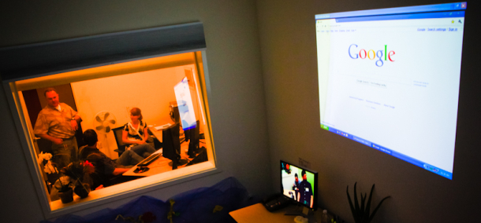
researchers explore the idea
What do you do online when you're not doing work?
Do you ever watch videos online? Show me.
How do you find videos online?
Have you ever shared an online video with other people?
Notes:
This is often foundational research

Slide 41
researchers use a variety of methods
usability studies
Notes:
This is an example of a user research lab at Google.

Slide 42

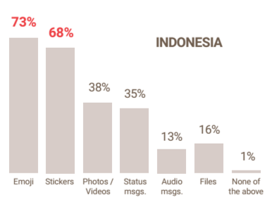
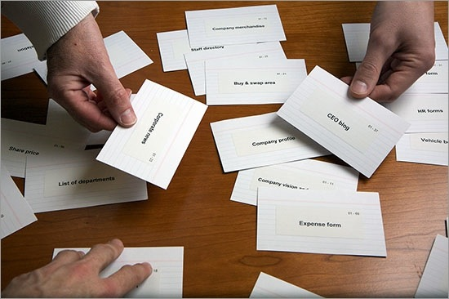
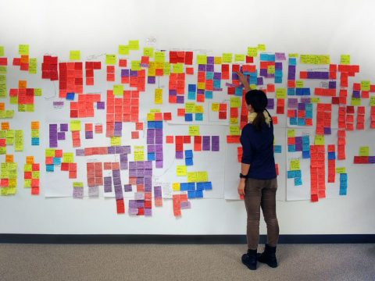
researchers use a variety of methods
surveys
field visits
card sorts
affinity diagrams
Notes:
A wide variety of methods
Lab studies, surveys, logs analysis, field visits, and more!

Slide 43
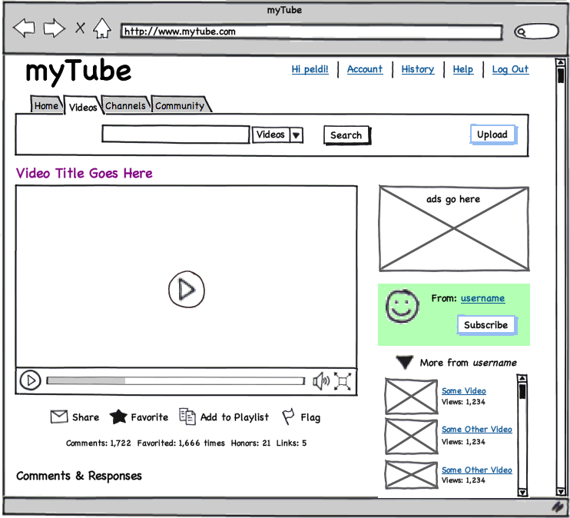
designers create rough designs & think about IA
Prototypers might also quickly create an interactive interface.
Notes:
We call these lo-fi
They are used for brainstorming, kicking off discussions, and further researhc

Slide 44
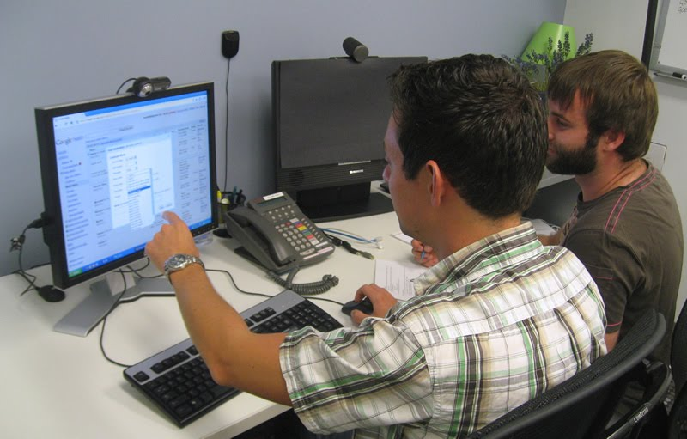
users use; researchers observe
How would you find popular videos this week?
What would you do after watching that?
Would you leave a comment? Why or why not?
What's going on on this page?
Notes:
Iterative testing and evaluation

Slide 45
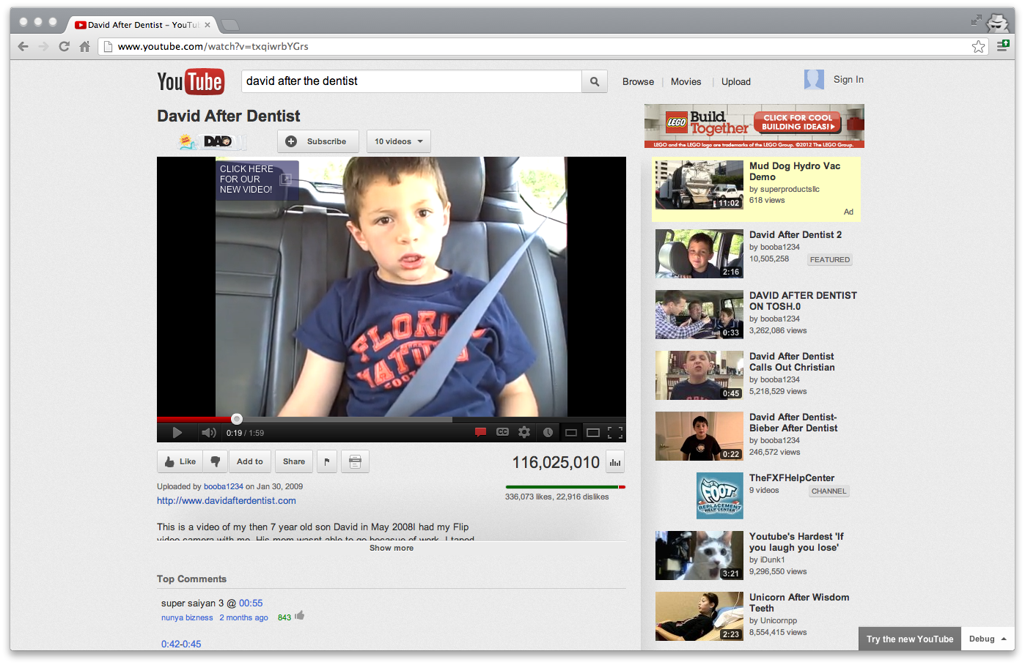
designers iterate based on the feedback
Visual designers focus on aligning all elements with the broader design system.

Slide 46
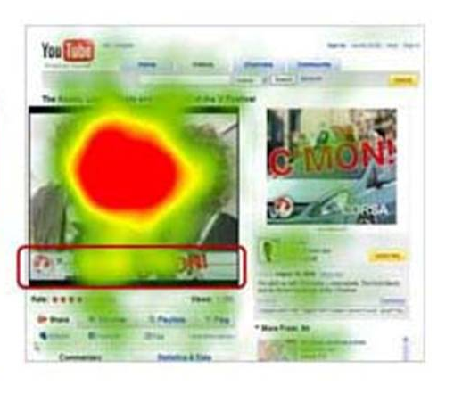
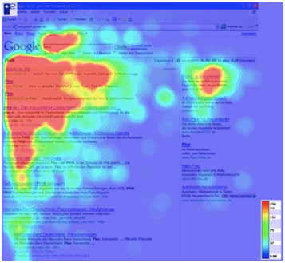
researchers continue to evaluate
Eyetracking studies

Slide 47
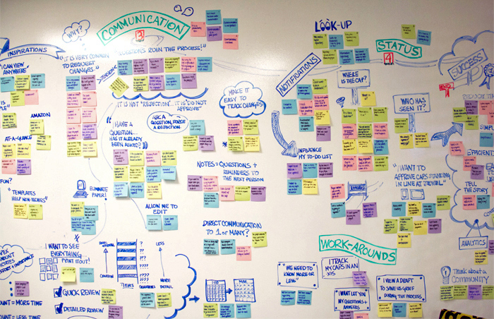
after each study
Researchers look for consistent themes and stories about the participants.
Researchers make recommendations and work with the eng and design team to prioritize findings.
Researchers typically put all their findings and recommendations into a “deliverable” of some sort.
Notes:
By creating deliverables, findings are archived.
Deliverables are invaluable for ramping up new team members.

Slide 48
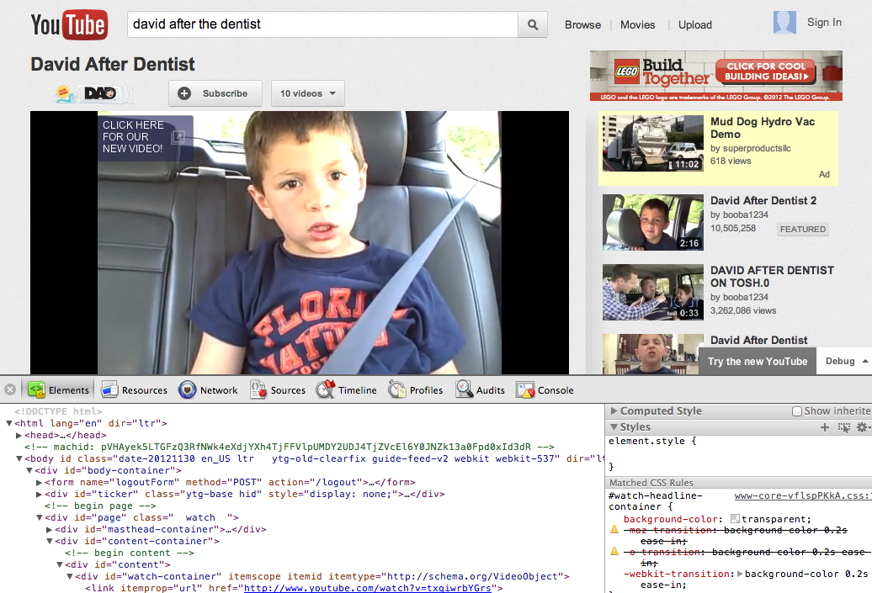
developers (engineers) implement
Notes:
After this, researchers and engineers will continue collaborating, learning about how real users are using the products through logs data and surveys, too.

Slide 49
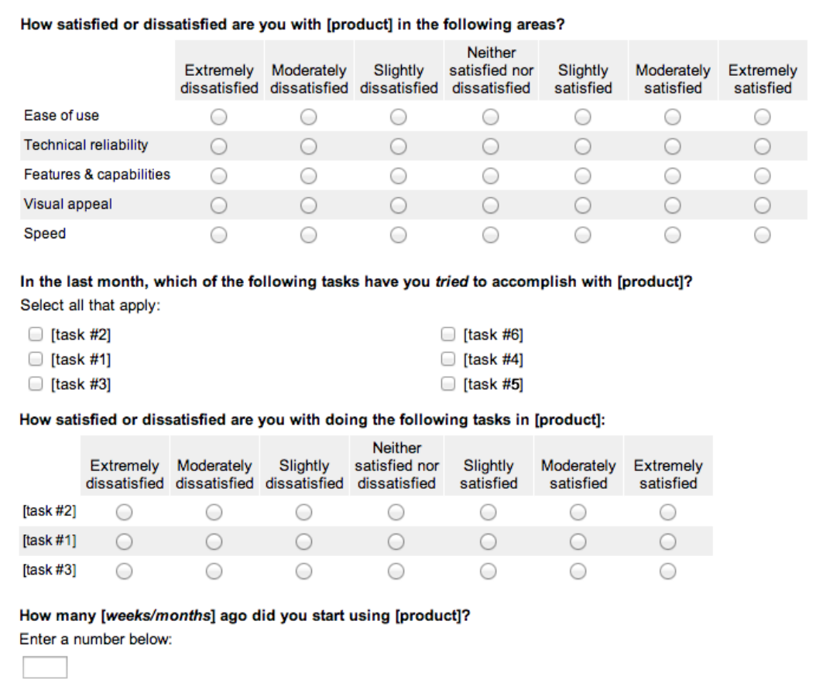
researchers continue to evaluate post launch
Happiness tracking post launch
Notes:
Following launches, researchers follow the progress with surveys and other quant methods like logs analysis

Slide 50
cross-team collaboration
Product Management
User Experience
Engineering
Notes:
Teams move in a triad model and are completely dependent on each of the three major groups.

Slide 51
the development process for UXers
Plan
Design
Build
Launch
Design
Explorations
Sketching
Storyboarding
Research
Competitive research
Field visits and interviews
User narratives
Stakeholder interviews
Task analysis
Surveys
Design
Information architecture
Wireframes
Mocks
High-fidelity prototypes
Research
Iterative lab studies on mocks and prototypes
Cognitive walkthroughs
Design
Polished mocks
Visual design
Icons and branding
Research
Iterative lab studies on live code
Cognitive walkthroughs
Surveys
Benchmarking studies
Design
Visual fit and finish
Bugs
V2 thinking
Research
Field research
Bugs
Benchmarking studies
Usage data analytics
Notes:
Ideally, both design and research is involved throughout the development cycle

Slide 52
hoping to hit all of these steps
Identify user needs/pain points
Define Problem
Release and Iterate
Create Concept
Develop Product
Design Interfaces
Notes:
We’re hoping to work with partners to hit all of these steps in the development cycle.

Slide 53
hoping to answer these 4 questions
WHO are you designing for?
What are the users’ NEEDS?
What are the TASKS users need to perform?
In what ENVIRONMENT will the product/feature be used?
Notes:
Most uX Researchers are social scientists who have a PhDs or Master degrees.
UX Researchers typically are trained in qualitative methods and have strong abilities to use quant data to answer research questions.

Slide 54
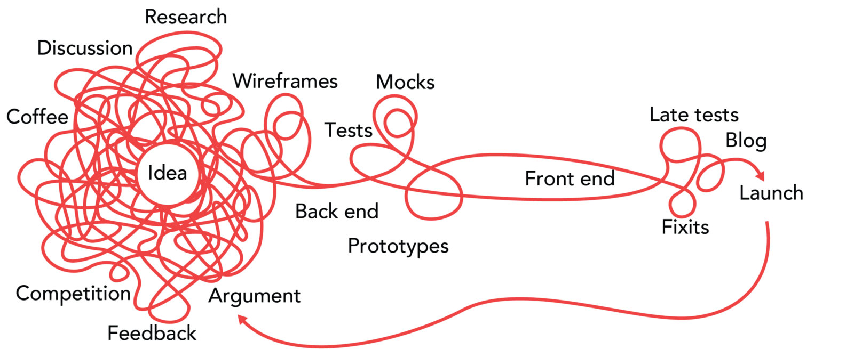
iterative product design
Notes:
But this is usually what happens… throw linear out and go for iterative and messy
Photo cred link

Slide 55
Notes:
Again, remember to keep your poker face when working with real users.

Slide 56
Thank you
questions?

Slide 57
UX Activity

Slide 58
review

Slide 59
UCD process answers these 4 core questions
WHO are you designing for?
What are the users’ NEEDS?
What are the TASKS users need to perform?
In what ENVIRONMENT will the product/feature be used?
Notes:
This is the key message to drive home… these are not easy to answer and require a lot of effort.
Consider designing a writing system for this environment v. a classroom.

Slide 60
it’s a team effort
Product
Legal
Marketing
Visual Design
UX
Interaction Design
Engineering
UX Research
Design Producing
Motion Design
Industrial Design
UX Engineering
UI Writing
Notes:
Within UX, we specialize based on our skills.
Visual design - focuses more on branding, color, type, cross-product look and feel
Interaction design - focuses on workflow, information architecture, solving design problems for all user cases across web and mobile (and other devices)
UX Research - focuses on udnerstanding the customers deeply - their needs, pain points, delighters, etc. Also work on evaluative and formative research to guide product decisions and design work.
Other areas are gaining strength at google…
Design producers
Motion Designers
Industrial Design
UX Engineering
UI Writing

Slide 61
the development process for UXers
Plan
Design
Build
Launch
Design
Explorations
Sketching
Storyboarding
Research
Competitive research
Field visits and interviews
User narratives
Stakeholder interviews
Task analysis
Surveys
Design
Information architecture
Wireframes
Mocks
High-fidelity prototypes
Research
Iterative lab studies on mocks and prototypes
Cognitive walkthroughs
Design
Polished mocks
Visual design
Icons and branding
Research
Iterative lab studies on live code
Cognitive walkthroughs
Surveys
Benchmarking studies
Design
Visual fit and finish
Bugs
V2 thinking
Research
Field research
Bugs
Benchmarking studies
Usage data analytics
Notes:
Ideally, both design and research is involved throughout the development cycle

Slide 62
hoping to hit all of these steps
Identify user needs/pain points
Define Problem
Release and Iterate
Create Concept
Develop Product
Design Interfaces
Notes:
We’re hoping to work with partners to hit all of these steps in the development cycle.

Slide 63
First… let’s sort into
Groups of 5 ppl

Slide 64
Our goal today:
Design a remote control for a streaming TV service for a unique user

Slide 65
Before you start designing, you must get to know your users by...

Slide 66
Start with the user
WHO. Identify the characteristics and capabilities of the user - physical characteristics, past experiences, expectations, etc.
NEEDS. High level needs that can be solved multiple ways (comfort, convenience, aesthetics, esteem, etc)
TASKS. The types of things the user wants to do (find shows, control volume, etc)
ENVIRONMENT. Where the viewing of the streamed shows will take place.

Slide 67
Then you will problem solve for your user...

Slide 68
Design thinking - broad steps
Identify user needs, pain points - talk to your user
Define the problem
Create a solution
Test your solution
Incorporate feedback

Slide 69
In your groups, decide your roles...

Slide 70
Roles
USER. You will help the team understand your characteristics, needs, tasks, and environment.
PRODUCT & RESEARCH. You will interview the user and make sure the eng and designer are understand and meet all the needs. You will test the ideas.
ENG & DESIGN. You will come up with ideas and sketches -- solutions to meet the scoped problem
*Flex in and out of these roles and work as a group
Notes:
Creativity will be needed for all roles.
Remember that everyone needs to understand the user and their needs, etc in UCD and UX.

Slide 71
Ready to meet your unique user?

Slide 72
More...
This is your user! You are designing a remote control as if it were alive.
Use the form of the RD to suggest actual physical capabilities and characteristics and build for that.
If it can turn its head, say so
If it can move, say so
Needs are for this user.
Tasks are for this user.
Environment is for this user.
Notes:
The users will tell you all about themselves ;)

Slide 73
More...
Think carefully about the need…
Large buttons is a design solution, what might the need be?
Confusing design solutions with the needs limits innovation
User need can usually be solved with multiple design solutions
Needs are higher level
Notes:
Large buttons for visibility
But another solution would be voice activation

Slide 74
Suggestions and guidelines are on the worksheet.
We’ll present out at 7:25
Notes:
Worksheet: https://docs.google.com/document/d/1jyw3xK6PpjZxukUCFDk2F1A6mNGdNY3iZNvaYBqRyN4/edit#

Slide 75
Appendix

Slide 76
Learn more about User Research
www.gv.com
http://www.usability.gov/
http://www.uxmatters.com/topics/user-research/
https://www.nngroup.com
Krug - Don’t Make Me Think
Norman - The Design of Everyday Things
Weinschenk - 100 Things Every Designer Needs to Know About People
Baxter, Courage, Cain - Understanding Your Users
Stone - User Interface Design and Evaluation

Slide 77
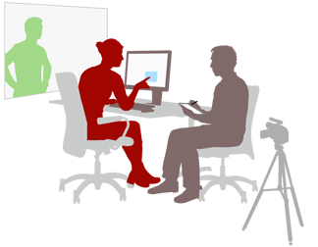
Conducting a study
Roles: Facilitator and Observer/Note-taker
Introduce the activity
No wrong answers
We’re evaluating the product, not you
Think-aloud protocol
Interview
Tasks with prototype

Slide 78
Interview Tips from Michael Margolis of GVentures
Get into character!
SMILE! :)
Be fascinated
Be neutral and encouraging
Don’t judge or dismiss
Build trust early in the relationship by going shallow then go deeper
Ask WWWWh questions - avoid Would you? Did you? Is it? Be OPEN ENDED!

Slide 79
Interview Tips from Michael Margolis of GVentures
Ask follow-up questions - what’s an example of that?
When in doubt, clarify - tell me more.
Answer questions with questions
Keep it personal - don’t generalize to others
Watch the time
Don’t do a pitch
Shut up and listen
Watch facial expressions, body language, and tone

Slide 80
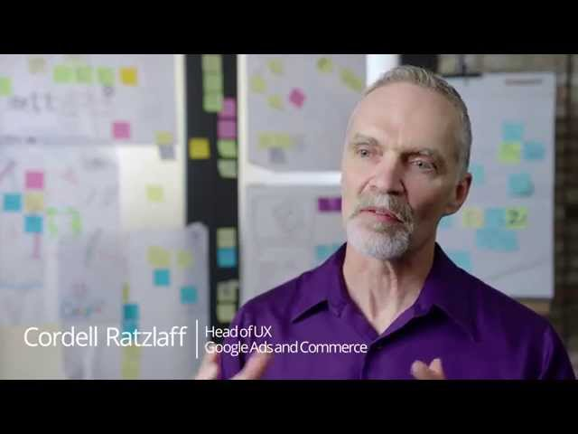
Notes:
Let’s take a look at a common method that we use to help define problems and explore solutions called “sprints”

Slide 81
How can you get into User Experience?

Slide 82
many paths
Design
Computer Science
Sociology
Psychology
Engineering
Statistics
Fine Art
Communications
Human-computer Interaction

Slide 83
What does Google look for?

Slide 84
designers
Solid academic background in human-computer interaction or related field (technical background a big plus.)
A design portfolio that demonstrates solid knowledge of web design principles.
Excellent knowledge of HTML, JavaScript, CSS for rapid prototyping purposes.
Strong, clean visual design sense.
Excellent leadership, communication and teamwork skills.

Slide 85
researchers
An advanced degree in HCI, cognitive psychology, information science or related field.
Strong analytical skills and an eye for what makes products usable and delightful
Strong understanding of strengths and shortcomings of different research methods, including when and how to apply them during each product phase.
Experience integrating user research into product designs and design practices
Can communicate findings in a clear and impactful way, and work well in cross-functional team environment.

Slide 86
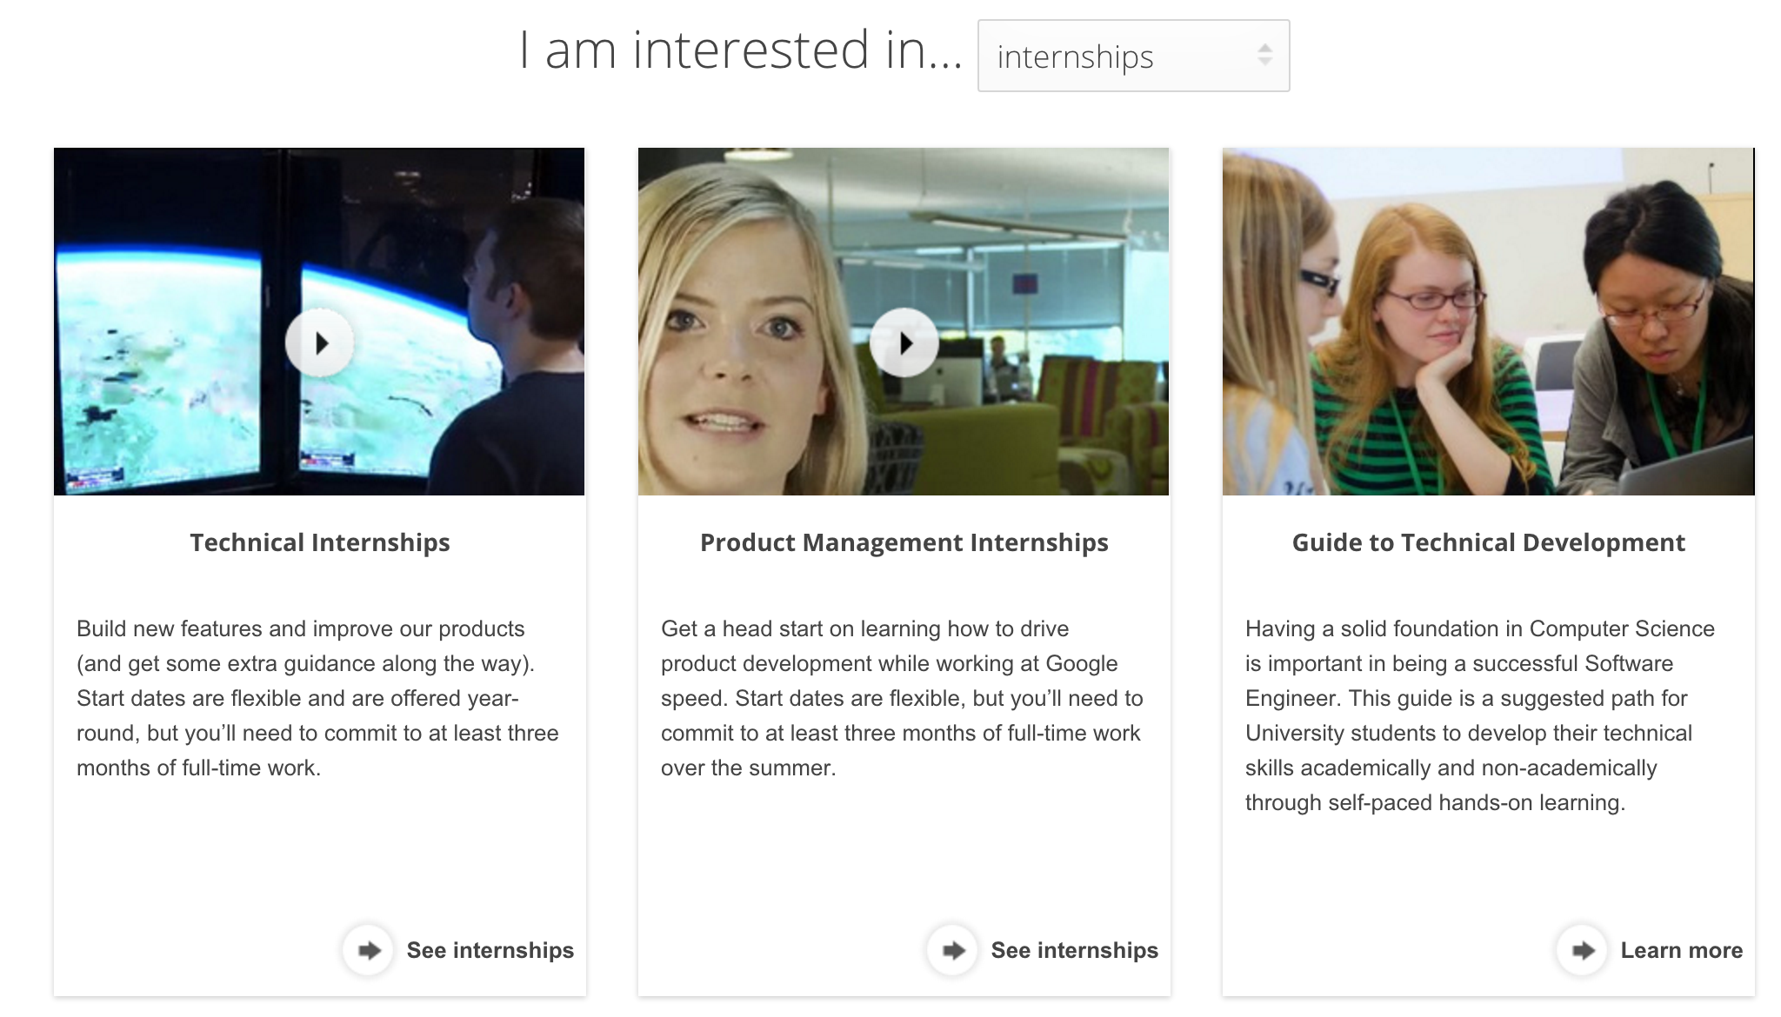
strongly suggest internships
http://www.google.com/about/careers/students/

